Slide 1
Class : Other Search Domains
Joshua Durso-Finley Course code:
joshua.durso-finley@mail.mcgill.ca

Slide 2
Outline

Slide 3

Table of Contents
Optimization
Hill Climbing
Simulated Annealing
Logic
Notes:
‹#›

Slide 4
Other types of Searches
Not all searches look like a graph problem
For example: Find the minimum of the function e^(x-2)^2
Notes:
‹#›

Slide 5
What methods exsist?
Gradient based methods: Newtons method…
Gradient Free Method: Brute force, search
Notes:
‹#›

Slide 6
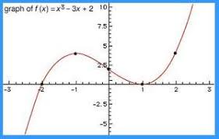
Optimization
We have a set of requirements i.e. a range of possible inputs
Different combinations of inputs are required
Optimize a cost function
We want a “good” solution
We can’t search every possibility
Notes:
‹#›

Slide 7
Optimization
The function doesn’t need to be continuous either
We could search for the optimal number of workers working different jobs by estimation production
This is one advantage over
gradient based methods
Notes:
‹#›

Slide 8
Examples
Scheduling
Given a set of tasks and constraints with some resources generate the shortest schedule
Circuit board layout
Given a board and some components place each component to minimize area used
Machine learning
Given a set of inputs and labels generate a decision tree to classify types of flowers
Notes:
‹#›

Slide 9
Requirements
Set of states/inputs
Evaluation Function
State space is too big to enumerate states(continuous or discrete)
Only care about the best solution not necessarily how we got there
Often the problem is NP-Hard
Notes:
‹#›

Slide 10
Types of search Methods
Constructive methods/roll-back methods
Start from scratch and build up a solution (TSP)
Iterative improvement
Start from any solution and try and swap inputs to improve (Scheduling)
Global search
Coarsely sample the entire state space (Function optimization)
Notes:
‹#›

Slide 11
Simple genetic algorithm
Start from initial configuration X0
While the solution hasn’t converged
Generate neighbors of Xi
Select one of the neighbors of Xi+1
The selected neighbor becomes the starting point
Problems?
Notes:
‹#›

Slide 12
Simple genetic algorithm
Start from initial configuration X0
While the solution hasn’t converged
Generate neighbors of Xi
Select one of the neighbors of Xi+1
The selected neighbor becomes the starting point
Problems?
Notes:
‹#›

Slide 13
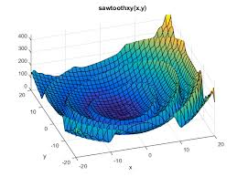
Simple genetic algorithm
Can be very greedy
There are many local minima
Notes:
‹#›

Slide 14
Hill climbing
Start with initial inputs
Iterate
Get neighboring points
Get the neighbor with the smallest value
If the original point was the one with the smallest value we are done
Else repeat with the smallest value
Notes:
‹#›

Slide 15
Hill climbing
Simple to program
Requires no memory
Can be run many times in parallel with different starting points
Notes:
‹#›

Slide 16
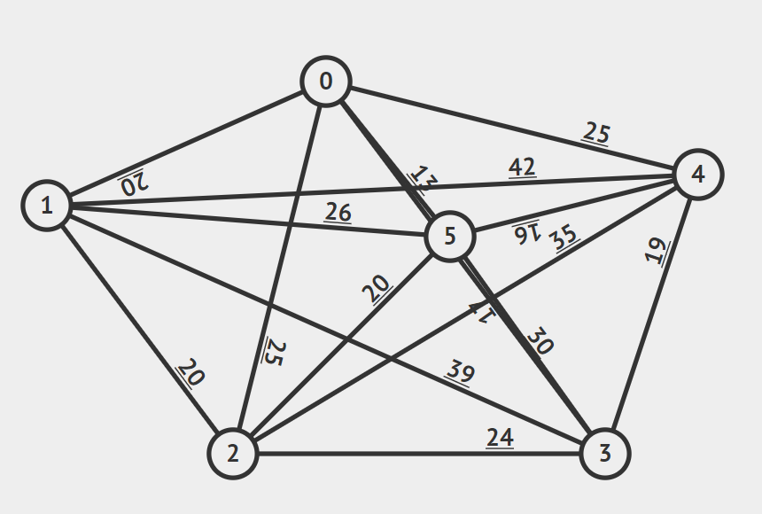
Example: Traveling Salesman Problem
Find the shortest path which visits all nodes
There are O(n!) options to choose from
https://visualgo.net/bn/tsp
Notes:
‹#›

Slide 17
Example: Traveling Salesman Problem
Start with any solution which visits all nodes
Take each of the nC2 vertices
nC2 comes from selecting two random
edges to swap and there are n edges
In a tour.
Runtime O(n^2)=n!/((n-2)!*2!)
Notes:
‹#›

Slide 18
Example: Traveling Salesman Problem
Start with any solution which visits all nodes
Take each of the nC3 vertices
nC3 comes from selecting three random
edges to swap and there are n edges
In a tour.
Runtime
O(n^3)=7*n!/((n-3)!*3!)
Notes:
‹#›

Slide 19
There’s a tradeoff
A smaller neighbor gives us fewer neighbors too look at so there is less computation but worse solutions
A bigger neighborhood gives more computation but jumps over fewer local optima
This is a design choice like a heuristic
What would be the neighbors for an optimization problem? Could we expand this?
Notes:
‹#›

Slide 20
Code the optimization activity
Notes:
‹#›

Slide 21
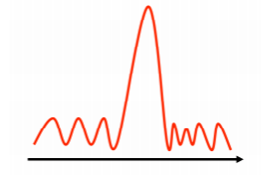
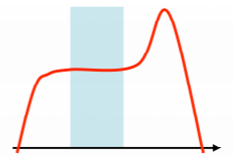
Problems with hill climbing
Gets stuck in local minima
Gets stuck in plateaus
Getting the neighborhood to solve all of these problems is quite difficult
Notes:
‹#›

Slide 22
Improvements
Run multiple trials from different starting locations and choose the absolute minimum
Randomized hill climbing: Choose any move which gives an improvement not necessarily the maximum
This doesn’t help us with local minima though
Notes:
‹#›

Slide 23
Ideas?
Notes:
‹#›

Slide 24
Proposal
Occasionally accept values which are worse
As we search more decrease the bad moves we are willing to accept
Algorithm
Start at initial configuration
Repeat:
Get a random neighbor
If E < Ei then X<-Xi and E<- Ei
Else with some probability p accept the move X<-Xi and E<-Ei
Remember best solution so far
Notes:
‹#›

Slide 25
What value should we use for p?
Depends on how bad the solution is
Depends on how far along in the algorithm we are
Neighbors with similar values should be similarly likely to be picked i.e. the selection process should be smooth
May be monotonic but not a requirement
Notes:
‹#›

Slide 26
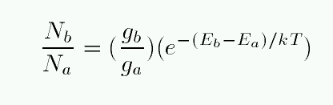
Simulated Annealing
This idea leads us to simulated annealing
Randomly select a proposal point
If the value is better select the new value
If the value is worse select according to a boltzmann distribution
Notes:
‹#›

Slide 27
Simulated Annealing
This equation weights two values against each other and returns a number between 0-1 which we can use as the probability of acceptance
The parameter kT is a constant which controls how much we care about the difference between two points. What happens as t-> infinity? As t->0? What should we start with? What should we go to?
If kT changes slowly enough we are certain to get the global optimum
Proof is mathematical but intuitively at an infinitely slow rate of change the entire state space can be explored
Notes:
‹#›

Slide 28
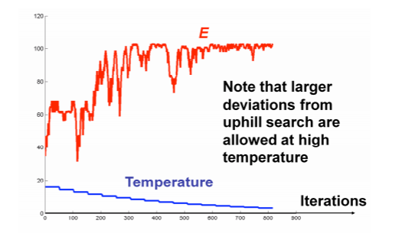
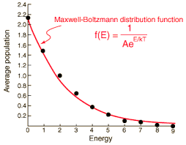
Simulated Annealing
Comes from Thermodynamics and is the probability of moving between states
States that are less energetic are more likely
As temperature increases that distinction is less important
Notes:
‹#›

Slide 29
In practice
Very useful algorithm for sampling
Temperature schedule is important
Can take many days to ensure a maximum but often there are few other options
Powerful for sparse state spaces with many peaks as it will explore the entire surface
Notes:
‹#›

Slide 30
Summary
Optimization problems are everywhere
We care only about getting the best solution or a solution of guaranteed quality
Enumeration is impossible
Local search algorithm
Random! Randomness gives us better results
Notes:
‹#›

Slide 31
Assignment
Random search
Search that occasionally selects values which decrease
Create a function with a few local optima and test
Notes:
‹#›

Slide 32
World building
Figure out a way to code the world
Represent facts
Build relationships between objects
Query to figure out results
Notes:
‹#›

Slide 33
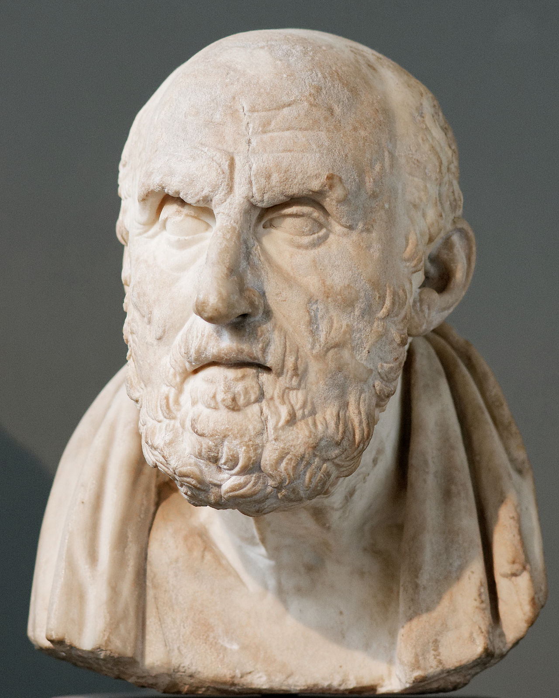
Propositional logic
Representation language and set of inference about facts that are either true or false
Notes:
‹#›

Slide 34
Knowledge bases
A list of propositional logic sentences that apply to the world
A knowledge base describes a set of worlds in which these facts and rules are true
For example:
Cold
ㄱRaining
(Raining ⋁ Cloudy) (Raining or Cloudy)
Cold ⇔ㄱHot (Cold implies and is implied by not hot)
Notes:
‹#›

Slide 35
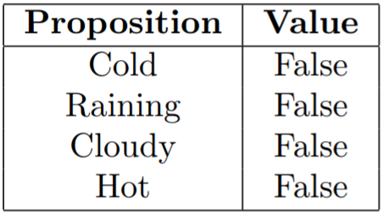
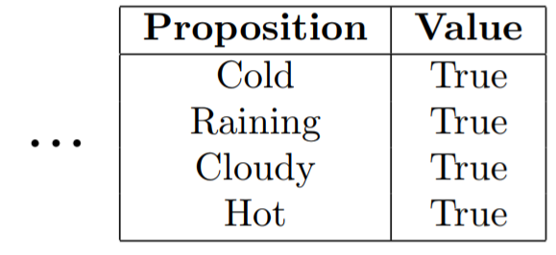
Knowledge bases
A model is a formalization of a world:
Every variable is either true or false
2^n models for n propositions
Notes:
‹#›

Slide 36
Knowledge bases
If a sentence is true in a model m then m satisfies the sentence
Cold Doesn’t satisfy
ㄱRaining Satisfies
Notes:
‹#›

Slide 37

Knowledge bases
The knowledge base specifies all possible models which satisfy all sentences
ㄱRaining, ㄱHot are my statements
Notes:
‹#›

Slide 38
Knowledge bases
Knowledge narrows down the set of possible worlds that exist i.e. 4 worlds satisfy these requirements
ㄱRaining, ㄱHot are my statements
Notes:
‹#›

Slide 39
Inference
Given a knowledge base what can we do?
We’d like to know more about the world
Inference: deriving new facts from given facts
Notes:
‹#›

Slide 40
Inference
If our knowledge base consists of two facts
Cold
Cold ⇔ㄱHot
We can ask: is it hot?
Based on our logical world bases in all worlds where Cold is true it is not hot
Notes:
‹#›

Slide 41
Inference
We say A entails B iff every model which satisfies A satisfies B
A is our current knowledge base and B is our Query
Based on what we know what worlds are logically consistent in every world
Notes:
‹#›

Slide 42
Inference
Algorithmically we want a method to prove a query Q using a set of inference rules
Ideally the algorithm is logically consistent and can prove all possible true statements
Notes:
‹#›

Slide 43
Inference
Could just enumerate all possible worlds and check the query in all of them. If the query is the same then the we can deduce the query
Cold, Cold ⇔ㄱHot
A query(Hot?) can be either true or false and a knowledge base can be consistent or not
 | F N | T Y | T Y | F N | F N | T Y | T Y | F N
Cold | False | True | False | True | False | True | False | True
Hot | False | False | True | True | False | False | True | True
Rainy | False | False | False | False | True | True | True | True
Notes:
‹#›

Slide 44
Inference
Formally written:
A⋁B ,ㄱB /A
Starting with A or B as a fact, Given evidence of not B,
what can we deduce about A?
 | F N | T Y | T Y | F N | F N | T Y | T Y | F N
Cold | False | True | False | True | False | True | False | True
Hot | False | False | True | True | False | False | True | True
Rainy | False | False | False | False | True | True | True | True
Notes:
‹#›

Slide 45
Inference
Cold,Cold ⇔ㄱHot
Cold =True
True ⇔ㄱHot
ㄱHot =True
Hot = False
 | F N | T Y | T Y | F N | F N | T Y | T Y | F N
Cold | False | True | False | True | False | True | False | True
Hot | False | False | True | True | False | False | True | True
Rainy | False | False | False | False | True | True | True | True
Notes:
‹#›

Slide 46
Inference
We start with a knowledge base
We can apply rules of logic to get to new places
There are many possible paths to take which we need to take in a certain order to reach a goal
Does this sound familiar?
Notes:
‹#›

Slide 47
Inference
Does this sound familiar?
Its a search problem!
States=True sentences, Starting State=Knowledge Base
actions=rules of inference, Goal test=Query in sentences, cost=1 cost per rule applied
Notes:
‹#›

Slide 48
Inference
Does this sound familiar?
Its a search problem!
States=True sentences, Starting State=Knowledge Base
actions=rules of inference, Goal test=Query in sentences, cost=1 cost per rule applied
Notes:
‹#›

Slide 49
Inference
Interesting way to go from observations to actions
Given what I have sensed… what can I deduce about the world
My sensors tell me the temperature is high and I am receiving a lot of sunlight. I can deduce it is summer and daytime
Not very powerful. I have to encode a lot of information in my knowledge base
Notes:
‹#›

Slide 50
First order logic
Worlds are composed of three operators
Objects e.g. apples
Functions e.g. Color(x),Shape(x)
Predicates e.g. IsApple(x),Adjacent(x,x)
Notes:
‹#›

Slide 51
First order logic
Objects are just things in the world
A apple
A color
The internet
Notes:
‹#›

Slide 52
First order logic
Functions map objects to a single object
Color(x) matches a real apple to the color red
Date of birth(x) takes a person and returns a date object
Notes:
‹#›

Slide 53
First order logic
Predicates-replace propositions
Like functions but return true or false
IsApple(x)
ParentOf(x,x)
Notes:
‹#›

Slide 54
First order logic
We build up a complex world by connecting predicates and functions
Cold(X) => Winter(X)
Dark(x) => Night
Food(x) =>(Savory(x) or sweet(x))
Notes:
‹#›

Slide 55
First order logic
Propositional logic-Make everything a variable. Check consistent worlds to drive inference
First order logic
A set of objects
A set of functions and values for inputs
A set of predicates and values for all objects
Notes:
‹#›

Slide 56
First order logic
Example world
Objects
Apple,Orance
Predicates
IsRed(x)
HasVitaminC(x)
Functions
OppositeOf(x)
Notes:
‹#›

Slide 57
First order logic
Can now ask a query
IsRed(OppositeOf(Apple)) -False
Notes:
‹#›

Slide 58
First order logic
Listing everything is incredibly tedious
All apples are the same
All sunny days are the same
We don’t need to specify each objects properties
Notes:
‹#›

Slide 59
Quantifiers
Quantifiers help us make generic statements
All fish have fins
There is a text book about AI
Always have a variable and a rule about that variable
Notes:
‹#›

Slide 60
Quantifiers
∃x, IsPresident(x)
There exists a temporary variable x such that the sentence is true
This is the existence quantifier
Notes:
‹#›

Slide 61
Quantifiers
∀x, HasStudenID(x) => Person(x)
For all x, if they have a student ID then they are a person
This is the universal quantifier
Notes:
‹#›

Slide 62
Quantifiers
Universal quantifiers ∀x are very strong so the sentence must be very general
Existential quantifiers are weak ∃x, so the sentence can be very specific
Notes:
‹#›

Slide 63
Quantifiers
Can be combined
∀x,∃y, Person(x) => Name(x,y)
Notes:
‹#›

Slide 64
Quantifiers
What do the following sentences say?
∀x, Bird(x) and Feathered(x)
∃y, Car(y) => ParkedIn(y,hotel_lot)
Notes:
‹#›

Slide 65
Quantifiers
What do the following sentences say?
∀x, Bird(x) and Feathered(x)
∃y, Car(y) => ParkedIn(y,hotel_lot)
In general, => is used for the for all operator, and and is used for the existence operator
Notes:
‹#›

Slide 66
Quantifiers
What do the following sentences say?
∀x, Bird(x) and Feathered(x)
∃y, Car(y) => ParkedIn(y,hotel_lot)
In general, => is used for the for all operator, and and is used for the existence operator
Notes:
‹#›

Slide 67
Instantiation
Now we no longer need variables because we have these universal quantifiers. We don’t need to write out worlds in which Fruit(apple) => Tasty(apple),Fruit(plane) => Tasty(plane). We don’t need to say planes aren’t tasty, apples are
Notes:
‹#›

Slide 68
Instantiation
There exists a process which converts sentences into a easy to search format called skolemization which expert systems of the past made use of
DENDRAL-Identified organic molecules
MYCIN-Identified bacteria causing infections
Problems with FOL-an expert needs to program and you are limited by the experts capabilities.
Notes:
‹#›

Slide 69
Logic
https://swish.swi-prolog.org/example/movies.pl
Needs to be cleaned up
Notes:
‹#›

